Slide 1
Lecture-6
Logical Database Design
Mapping ERD to Relational
Thepul Ginige

Slide 2
Objectives
How to remove features from a local conceptual model that are not compatible with the relational model.
How to derive a set of relations from a logical data model (ER (EER) diagram).

Slide 3
Transforming ERD into Relations
Transforming (mapping) E-R diagrams to relations is a relatively straightforward process with a well-defined set of rule
Step 1: Map Strong Entities
2: Map Weak Entities
3: Map Binary Relationships
4: Map Unary Relationships
5: Map Complex Relationships
6: Map Supertype/Subtype Relationships
7: Map Categories

Slide 4
Transforming ERD into Relations
Remove features not compatible with the relational model (optional step)
To refine the local conceptual data model to remove features that are not compatible with the relational model. This involves:
  remove M:N binary relationship types;
  remove M:N recursive relationship types;
  remove complex relationship types;
  remove multi-valued attributes.

Slide 5
Map Strong Entity Types
Strong entity types
  Create a relation that includes all simple attributes of that entity. For composite attributes, include only constituent simple attributes.
Entity Relation
entity name relation name
simple attribute attribute of the relation
entity identifier primary key of relation
composite attribute component attributes

Slide 6
Map Strong Entity Types
First Name
Emp No
Mid Initials
NID
Emp Name
Last Name
Address
Employee
(Emp_No, NID, Address,
Salary, Gender, DOB,
Employee
First_Name, Mid_Initials,
Last_Name)
Salary
Gender
DOB

Slide 7
Remove multi-valued attributes
Multi-valued attributes
  Create new relation to represent multi-valued attribute and include primary key of entity in new relation, to act as a foreign key.
  Unless the multi-valued attribute is itself an alternate key of the entity, primary key of new relation is combination of the multi-valued attribute and the primary key of the entity.
Dept_Location(Dept_No, Location)

Slide 8
Map Weak Entity Types
Weak entity types
  Create a relation that includes all simple attributes of that entity.
  Primary key is partially or fully derived from each owner entity.

Slide 9
Map Weak Entity Types
Emp No
Employee
1
has
N
Dependent
Depd Name
Gender
Relationship
DOB
Emp_No,
Dependent( Depd_Name, Gender, DOB, Relationship)

Slide 10
Map Binary Relationships
Procedure depends on both the degree of the binary relationships and the cardinalities of the relationships
  Map Binary One-to-Many (1:N) Relationships
  Map Binary Many-to-Many (M:N) Relationships
  Map Binary One-to-One (1:1) Relationships

Slide 11
1:N binary relationship types
  Entity on ‘one side’ is designated the parent entity and entity on ‘many side’ is the child entity.
  Post copy of the primary key attribute(s) of parent entity into relation representing child entity, to act as a foreign key.
  Include any attributes of the relationship to the relation of the many side

Slide 12
1:N binary relationship types
Location
Dept Name
Phone
FK
Dept No
Department(Dept_No, Dept_Name, Phone)
Department
control
Proj No
Project(Proj_ No, Proj_Name, Location
Project
, Dept_No)
Location
Proj Name

Slide 13
1:1 binary relationship types
  More complex as cardinality cannot be used to identify parent and child entities in a relationship.
  Instead, participation used to decide whether to combine entities into one relation or to create two relations and post copy of primary key from one relation to the other. Consider following:
  (a) total participation on both sides of 1:1 relationship;
  (b) total participation on one side of 1:1 relationship;
  (c) partial participation on both sides of 1:1 relationship.

Slide 14
Total participation on both sides of 1:1 relationship
Combine entities involved into one relation and choose one of the primary keys of original entities to be primary key of new relation, while other (if one exists) is used as an alternate key.

Slide 15
Total participation on one side of a 1:1 relationship
Identify parent and child entities using participation constraints.
Entity with partial participation is designated parent entity, and other entity designated child entity.
Copy of primary key of parent placed in relation representing child entity.
If relationship has one or more attributes, these attributes should also be included in the child relation.

Slide 16
First Name
Emp No
Mid Initials
Location
NID
Emp Name
Last Name
Dept Name
Address
Phone
Dept No
Employee
Start d
Department
manage
Salary
Gender
DOB
Employee(Emp_No, NID, Address, Salary, Gender, DOB, First_Name, Mid_Initials, Last_Name, Dept_No)
FK
Department(Dept_No, Dept_Name, Phone
, Manager,
Start_D)

Slide 17
Partial participation on both sides of a 1:1 relationship
Designation of the parent and child entities is arbitrary unless can find out more about the relationship.
Consider employee Uses Car is a 1:1 relationship with partial participation on both sides. Assume majority of cars, but not all, are used by employees.
Car entity, although partial, is closer to being total than Staff entity. Therefore designate Staff as parent entity and Car as child entity.

Slide 18
Map M:N binary relationship types
Create relation to represent relationship and include any attributes that are part of relationship.
  Post a copy of the primary key attribute(s) of the entities that participate in relationship into new relation, to act as foreign keys.
  These foreign keys will also form primary key of new relation, possibly in combination with some of the attributes of the relationship.

Slide 19
First Name
Emp No
FK/NN
Mid Initials
NID
Emp Name
Last Name
Address
Employee(Emp_No, NID, Address, Salary, Gender, DOB, First_Name, Mid_Initials, Last_Name, Dept_No)
Employee
Project(Proj_ No, Proj_Name, Location, Dept_No)
Salary
works on
Hours
FK/NN
Gender
DOB
Works_On(Emp_No, Proj_No
, Hours)
Project
Location
Proj Name
Proj No

Slide 20
Map Unary Relationships
Procedure depends on the cardinalities of the relationships
  Map Unary One-to-Many Relationships
  Map Unary Many-to-Many Relationships
  Map Unary One-to-One Relationships

Slide 21
Map Unary One-to-Many Relationships
Create a relation for the entity type
Include PK of the entity as a foreign key within the same relation
Include any attributes of the relationship to the relation of the many side

Slide 22
Map Unary One-to-Many Relationships
First Name
NID
Mid Initials
Emp Name
supervise
Last Name
Address
1
N
Salary
Emp No
Gender
Employee
DOB
Employee(Emp_No, NID, Address, Salary, Gender, DOB, First_Name, Mid_Initials, Last_Name, Dept_No,
Supervisor)
FK/Null

Slide 23
Map Unary Many-to-Many Relationships
Create a relation for the entity type
Create new relation and include PK of the entity type as FK twice. These attributes become the PK (composite)
Include any attributes of the relationship to the new relation

Slide 24
Map Unary Many-to-Many Relationships
Quantity
contain
Name
Item No
Item
Unit Cost
Item(Item_No, Name, Unit_Cost)
FK/NN
Component(Item_No, Component_No, Quantity)
FK/NN

Slide 25
Map Unary One-to-One Relationships
Create a relation for the entity type
Include PK of the entity as a foreign key within the same relation

Slide 26
Map Unary One-to-One Relationships
First Name
NID
Mid Initials
Emp Name
marry
Last Name
Address
Salary
Emp No
Gender
Employee
DOB
Employee(Emp_No, NID, Address, Salary, Gender, DOB, First_Name, Mid_Initials, Last_Name, Dept_No,
Marry)
FK/Null

Slide 27
Map Complex relationship types
Create relation to represent relationship and include any attributes that are part of the relationship.
  Post copy of primary key attribute(s) of entities that participate in the complex relationship into new relation, to act as foreign keys.
  Any foreign keys that represent a ‘many’ relationship generally will also form the primary key of new relation, possibly in combination with some of the attributes of the relationship.

Slide 28
Map Complex relationship types
Part
ShippingMode
Supplier
Supplies
UnitCost
Project
Supplier(supplier_no, ….)
Project(project_no, ….)
Part(part_no, ….)
Supply(supplier_no, project_no, part_no, Shipping_mode, Unit_Cost)

Slide 29
Mapping Associative Entities
Follow similar steps to mapping an M:N relationship
Three relations are created, one for each of the two participating entity types and the third for the associative entity.
The relation formed is called the associative relation.

Slide 30
Identifier Not Assigned
The default primary key for the associative relation consists of the two primary key attributes from the other two relations.
These attributes are then foreign keys that reference the other two relations.

Slide 31
Identifier Assigned
Sometimes an identifier (called a surrogate identifier or key) is assigned to the associative entity type on the ER diagram. There are 2 possible reasons:
i) The associative identity type has a natural identifier that is familiar to end users
ii) The default identifier (consisting of identifiers for each of the participating entity types) may not uniquely identify instances of the associative identity

Slide 32
Identifier Assigned
A new associative relation is created to represent the associative entity
However, the primary key for this relation is the identifier assigned on the ER diagram
The primary keys for the two participating entity types are then included as foreign keys in the associative relation

Slide 33
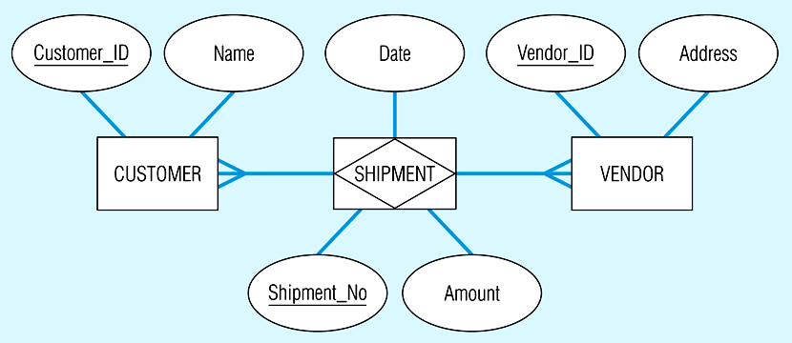
Mapping an associative entity

Slide 34
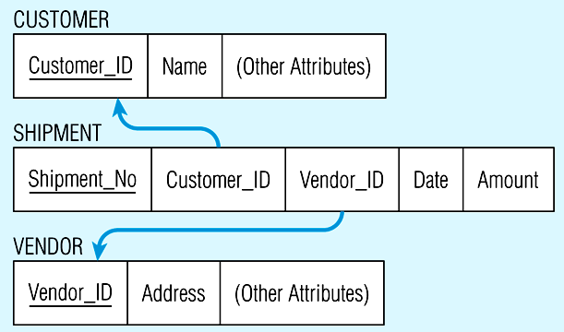

Slide 35
Map Supertype/Subtype Relationships
The relational model does not directly support supertype/subtype relationships
There are various strategies that database designers can use to represent these relationships with the relational data model

Slide 36
Map Superclass/subclass relationship types
  Identify superclass as parent entity and subclass entity as child entity.
  There are various options on how to represent such a relationship as one or more relations.
  Most appropriate option dependent on number of factors such as:
    disjointness and participation constraints on the superclass/subclass relationship,
    whether subclasses are involved in distinct relationships,
    number of participants in superclass/subclass relationship.

Slide 37
Mapping Superclass / Subclass Relationship
Participation Constraint – Partial
Disjoint Constraint - Disjoint
1. Create a relation for superclass
2. Create a relation for each subclass such that:
{primary_key of superclass} U {attributes of subclass}
key for subclass is (primary_key of superclass)
Employee
d
∩
∩
∩
Secretary
Technician
Engineer
TypingSpeed
TGrade
EngType

Slide 38
Partial , Disjoint
Employee
Ssn | FName | Mlnit | LName | B’date | Address | JobType
Secretary
Technician
Ssn | TypingSpeed
Ssn | TGrade
Engineer
Ssn | EngType

Slide 39
Mapping Superclass / Subclass Relationship
Participation Constraint – Total
Disjoint Constraint - Disjoint
Create a relation for each subclass such that:
{primary_key of superclass} U {attributes of superclass} U {attributes of subclass}
key for each relation is (primary_key of superclass)
Employee
d
∩
∩
Salary
PayScale
Salaried-Employee
Hourly_Employee

Slide 40
Total, Disjoint
Salaried_ Employee
Ssn | FName | Mlnit | LName | B’date | Address | JobType | Salary
Hourly_ Employee
Ssn | FName | Mlnit | LName | B’date | Addr. | JobType | PayScale

Slide 41
Mapping Superclass / Subclass Relationship
Participation Constraint – Partial
Disjoint Constraint - Overlap
Create a relation for superclass
Create a combined relation for all subclasses such that:
{primary_key of superclass} U {attributes of all subclasses} U {with one or more discriminators to distinguish the subclass type}
key for each relation is (primary_key of superclass)

Slide 42
Partial, Overlap
Person
o
∩
∩
Employee
Year
Student
Designation
salary
DegreeProgram

Slide 43
Person
NID | FName | Mlnit | LName | B’date | Sex | Address
Emp_Stud
NID | Salary | Designation | DegreeProgram | Year | Emp.Flag | Student Flag

Slide 44
Mapping Superclass / Subclass Relationship
Participation Constraint – Total
Disjoint Constraint - Overlap
Create one relation such that:
{primary_key of superclass attributes} U {attributes of superclass} U {attributes of all subclasses} U {type attribute}

Slide 45
Total, Overlap
Part
Description
PartNo
o
ManufacturedDate
∩
∩
Manufactured_Part
ListPrice
Purchased_Part
DrawingNo
BatchNo
SupplierName
Part {PartNo,Description,ManufacturedDate,DrawingNo,BatchNo,
SupplierName,ListPrice,ManufacFlag,PurchFlag}

Slide 46
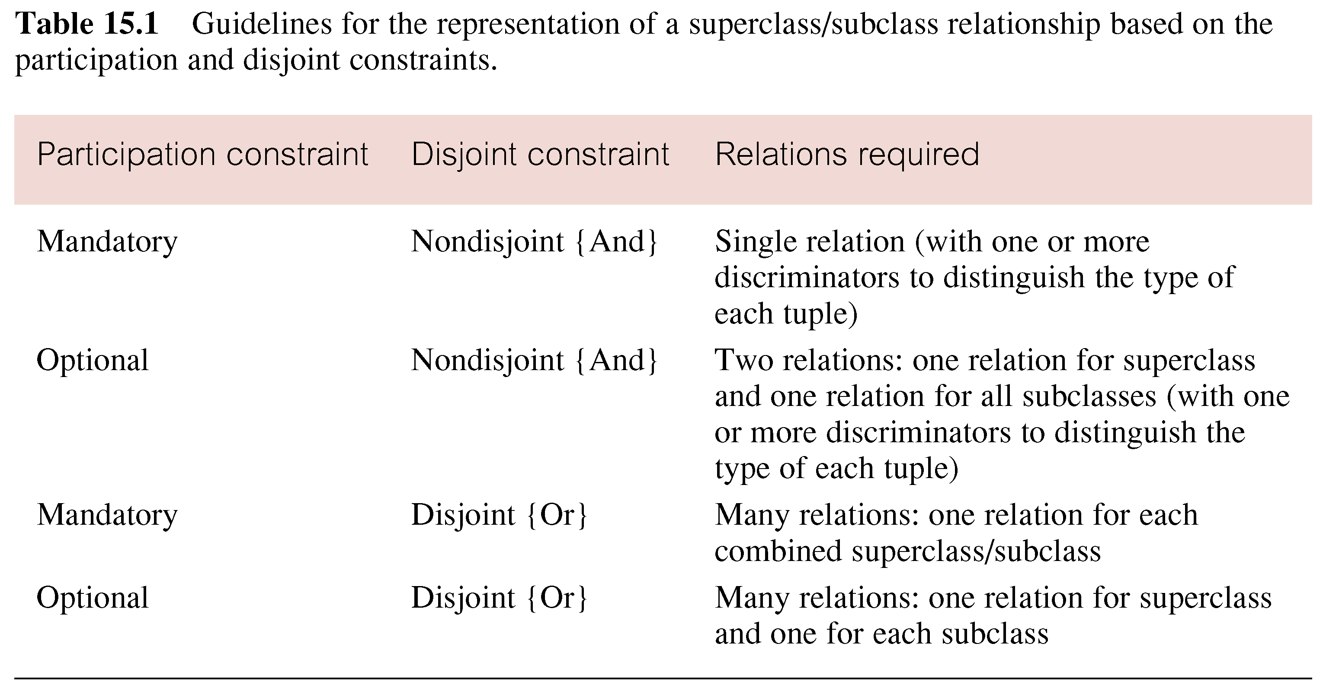
Guidelines for Representation of Superclass / Subclass Relationship

Slide 47
Mapping of categories
If the super-classes have different keys we have to define a new key attribute called a ‘surrogate key’. When creating a relation to correspond to the category.
Create a relation to correspond to the category, include any attributes of the category. The primary key is the surrogate key
Each super-class is also mapped into a relation with its own primary key, the surrogate key becomes a foreign key for this.

Slide 48
Mapping of categories
BANK
BName
PERSON
COMPANY
personid
compid
U
∩
Person(PersonID,name,…,OwnerID)
Company(CompID,name,…,OwnerID)
Owner(OwnerID, OwnerType)
OWNER

